Slide 1
Development of Route30
A Free and Open-Source Software Client-Side Routing Library
George Adams
Southwest Research Institute®
San Antonio, Texas
and
MGIS Program, Penn State
Texas GIS Forum
March 9, 2022

Slide 2
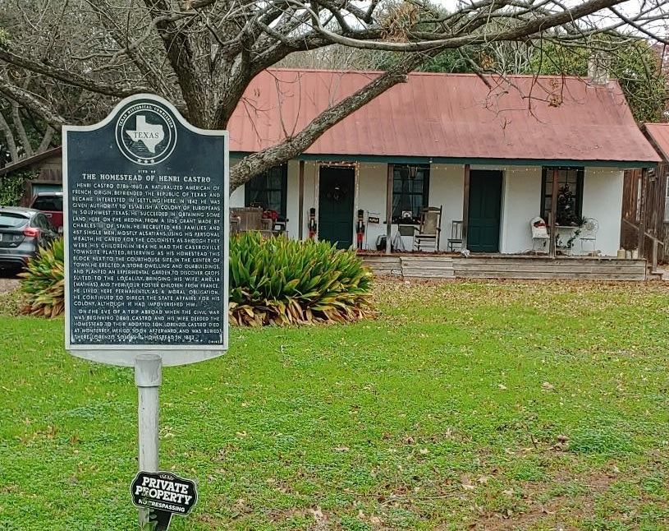
Overview
Objective:
To develop a user-configurable* client-side routing library
Demonstrate its functionality in an historical walking-tour web app
Characteristics of Route30:
Free and open-source software (FOSS)
Easy, affordable solution
Client-side library
Dynamic route generation
Henri Castro Homestead in Castroville, Texas - 1845
*User-configurable: the library allows an app user (or tourist) to filter points of interest (POIs) and constrain the route.

Slide 3

Outline
Routing: An optimal path is defined in a real-world geographical space through user-defined points of interest.
Background on routing
Routing library design
Web app implementation
How you can use the library
Benefits to using the library

Slide 4
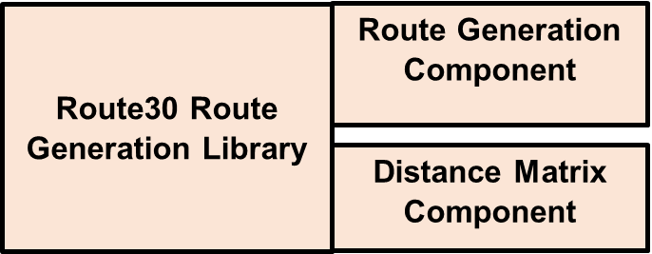
Outline
Background on routing
Routing library design
Web app implementation
How you can use the library
Benefits to using the library

Slide 5
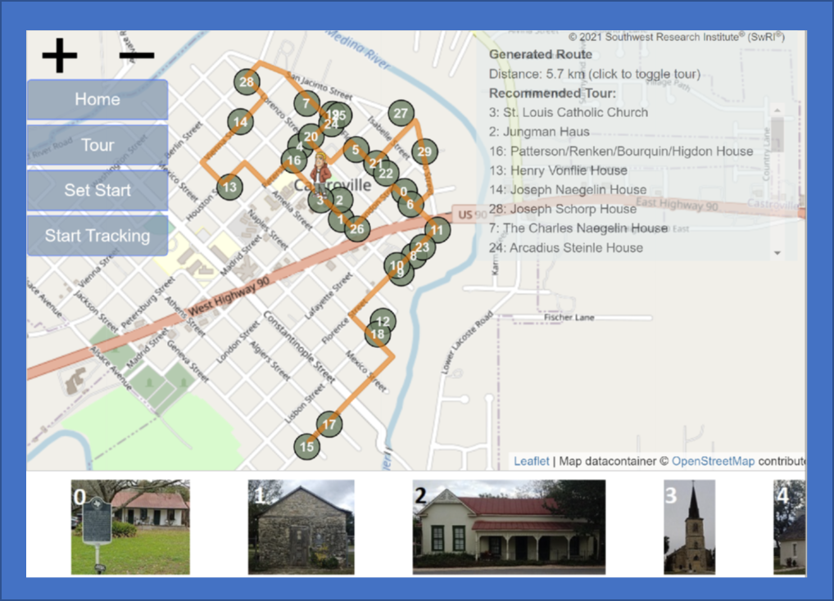
Outline
Background on routing
Routing library design
Web app implementation
How you can use the library
Benefits to using the library

Slide 6
Outline
Web App
Background on routing
Routing library design
Web app implementation
How you can use the library
Benefits to using the library
1
3
4
Route30 Library
2
Files

Slide 7
Outline
Server-Side Solution
5.7 km
Background on routing
Routing library design
Web app implementation
How you can use the library
Benefits to using the library
OpenRouteService (The Heidelberg Institute for Geoinformation Technology, 2022)

Slide 8
Background
Routing Library Design
Web App Implementation
How You can use the Library
Benefits to using the Library

Slide 9

The Traveling Salesman Problem
Background
Given a set of Points of Interest (POIs), find the optimal (i.e., shortest) path among those POIs.
Optimal Path
Optimal Path through Six POIs

Slide 10

The Traveling Salesman Problem
Background
Number of distinct paths goes up rapidly with Points of Interest (POIs)
6 POIs
7 POIs
Add one more POI
60 Distinct Paths
360 Distinct Paths

Slide 11
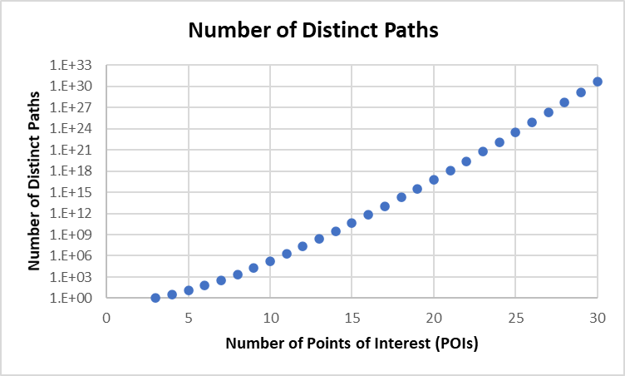
The Traveling Salesman Problem
Background
Paths increase as
(n-1)!/2, where n is the number of POIs (Curry, 2020)
4.4 x 10³⁰
Brute force solution quickly becomes infeasible
Find a solution close to the optimal (i.e., shortest) route

Slide 12
The Traveling Salesman Problem
Background
Also, paths are frequently not simple straight lines between POIs
Paths follow a street network

Slide 13
Goals for the Route30 Routing Library
Background
Find a solution close to optimal, efficiently
Build the path along a street network
Manage constraints
User
Street network

Slide 14
Background
Routing Library Design
Web App Implementation
How You can use the Library
Benefits to using the Library

Slide 15
Distance Matrix Component
Design
Find the shortest path between every pair of POIs
Route30 Route Generation Library
Route Generation Component
Distance Matrix Component
POI | 1 | 2 | 3 | 4 | 5 | 6
1 | Null | 1.3 | 1.7 | 2.5 | 3.1 | 2.6
2 | 1.3 | Null | 1.2 | 1.8 | 2.1 | 1.9
3 | 1.7 | 1.2 | Null | 0.9 | 1.4 | 1.7
4 | 2.5 | 1.8 | 0.9 | Null | 1.9 | 1.2
5 | 3.1 | 2.1 | 1.4 | 1.9 | Null | 0.7
6 | 2.6 | 1.9 | 1.7 | 1.2 | 0.7 | Null
4
3
1.3 km from POI 1 to POI 2
2.5
1.7
3.1
2
5
1.3
2.6
1
6

Slide 16
A-Star Algorithm
Design
Edges are street segments between intersections
Nodes are intersections
Finds the shortest path between two POIs
Searches along the nodes and edges of a street network
5
1
Lester (2005), Roy (2019), and Swift (2017) describe the A-Star algorithm.

Slide 17
A-Star Algorithm
Design
Focuses on paths directly between the two points
Can backtrack to identify alternative, better paths
5
1
Focus Region

Slide 18
Barriers Exist on Street Networks
Design
Street segment (edge) barriers
Intersection (node) barriers
Street segment (edge) passes through elementary school campus and is fenced off.
Edges File
Street network is from Harvard Dataverse (Boeing, 2017).

Slide 19
Barriers Exist on Street Networks
Design
Street segment (edge) barriers
Intersection (node) barriers
Highway 90 splits the historic district.
One of two crosswalks
Nodes File
Street network is from Harvard Dataverse (Boeing, 2017).

Slide 20
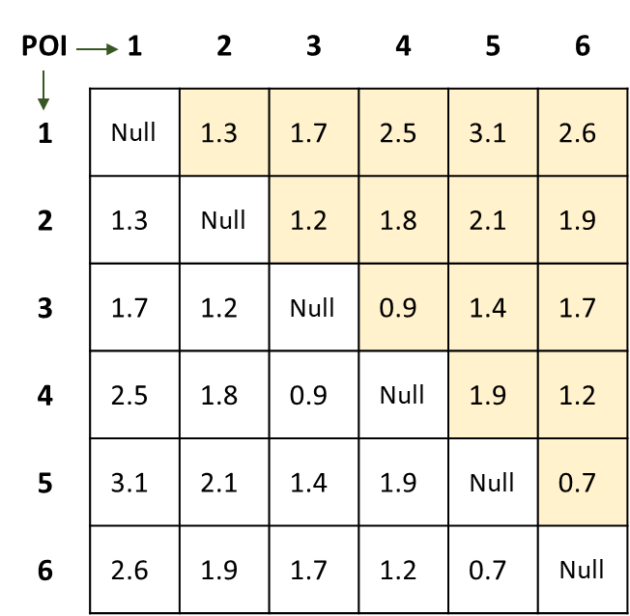
Routing Library Design
Design
Each cell contains the shortest path and its associated distance
Route30 Route Generation Library
Route Generation Component
Route30 Route Generation Library
Route Generation Component
4
Distance Matrix Component
3
Distance Matrix Component
Creates distance matrix for
Route Generation Component
5
2
6
1
2.6 km
Input is a POI file and a street network (nodes and edges files)
Distance Matrix

Slide 21
Route Generation Component
Design
Finds a best solution and generates a route that is close to optimal
Route30 Route Generation Library
Route Generation Component
Distance Matrix Component
Simulated annealing

Slide 22
Simulated Annealing
Design
Analogy to metallurgy – lower the temperature slowly
At each “temperature” test alternatives
Perform transport or reversal
Check the new total distance
Accept a better solution
Maybe accept a solution that is not better
Goal is to find a global minimum where many local minima may exist
4
3
5
2
6
1
Lojkine (2018), Jacobson (2013), Press et al. (1992), Schneider (2014), and Walker (2018) describe the simulated annealing approach.

Slide 23
Simulated Annealing - Example
Design
Pick a route at random
Calculate the distance
4
3
Distance
Original Route
3,5,2,1,6,4
4.8 km
5
2
6
1

Slide 24
Simulated Annealing - Example
Design
Pick a transformation. Flip a coin and select either:
Reverse or
Transport
4
3
Distance
Original Route
3,5,2,1,6,4
4.8 km
5
2
6
1

Slide 25
Simulated Annealing – Reverse Process
Design
Reverse Selected
Pick a segment at random
Reverse the nodes
Calculate new distance
4
4
3
3
Distance
Original Route
3,5,2,1,6,4
4.8 km
5
5
2
2
Segment
2,1,6
Accept new route because distance is less
Reverse
6,1,2
6
6
1
1
New Route
3,5,6,1,2,4
4.2 km

Slide 26
Simulated Annealing – Transport Process
Design
Transport Selected
First, pick a random segment. Then, pick a random location on the remaining route.
Transport the segment to that location
Calculate new distance
4
4
3
3
Distance
Original Route
3,5,6,1,2,4
4.2 km
5
Location zero
5
2
Maybe accept new route. It depends on the temperature.
2
Segment
1,2
Random Location
0
6
6
1
1
New Route
1,2,3,5,6,4
4.6 km
The probability of acceptance decreases as temperature decreases

Slide 27
Simulated Annealing
Design
Configuration parameters: Maximum Successes and Maximum Attempts
Perform transport or reversal process
Lower the “temperature”
4
3
Maximum successes reached?
Yes
Yes
Any successes?
No
5
2
Maximum attempts reached?
Yes
No
6
1
Return best solution
No
Final Route
3,4,5,6,1,2
Note: A success is a new route accepted by the algorithm.

Slide 28
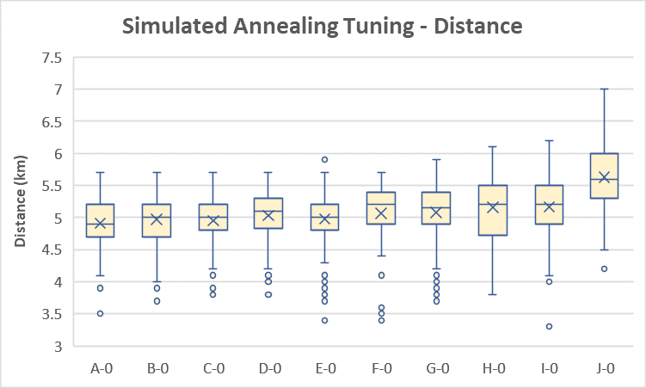
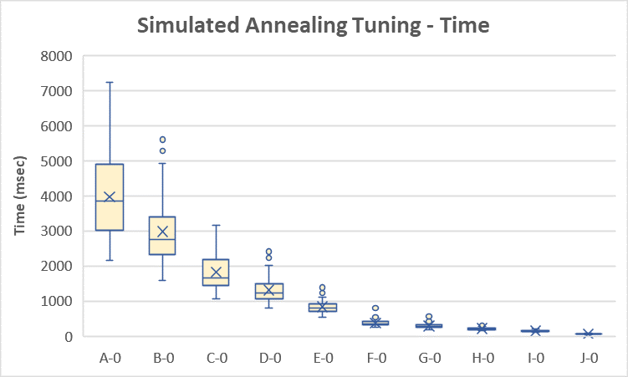

Tuning the Simulated Annealing Algorithm
Design
Tune Maximum Attempts
Selected 20 random POIs out of 30 for each repetition – 100 repetitions total

Slide 29
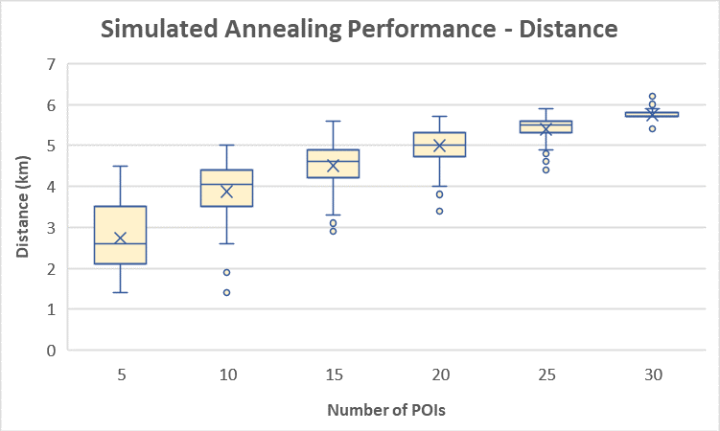
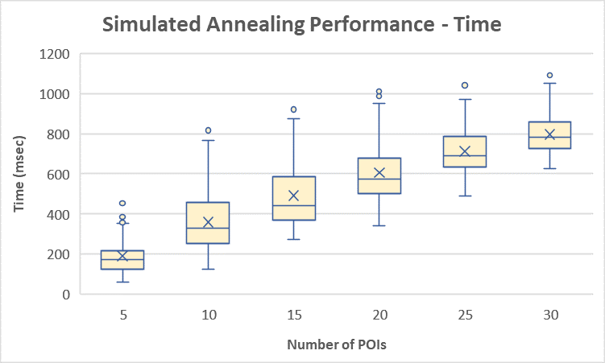
Examine the Performance
Design
Change the number of POIs
Selected POIs randomly out of 30 for each repetition – 100 repetitions total

Slide 30
Background
Routing Library Design
Web App Implementation
How You can use the Library
Benefits to using the Library

Slide 31
Demo Web App
Implementation
Demonstrates a walking tour through the historical district in Castroville, Texas
The tourist can
Build a tour
Set their start position
Track their position
Web app URL: https://personal.psu.edu/gra35/GEOG596B/tourR30.html

Slide 32
Demo Web App
Implementation
Demonstrates a walking tour through the historical district in Castroville, Texas
The tourist can
Build a tour
Set their start position
Track their position
Web app URL: https://personal.psu.edu/gra35/GEOG596B/tourR30.html

Slide 33
Demo Web App
Implementation
Demonstrates a walking tour through the historical district in Castroville, Texas
The tourist can
Build a tour
Set their start position
Track their position
Web app URL: https://personal.psu.edu/gra35/GEOG596B/tourR30.html

Slide 34
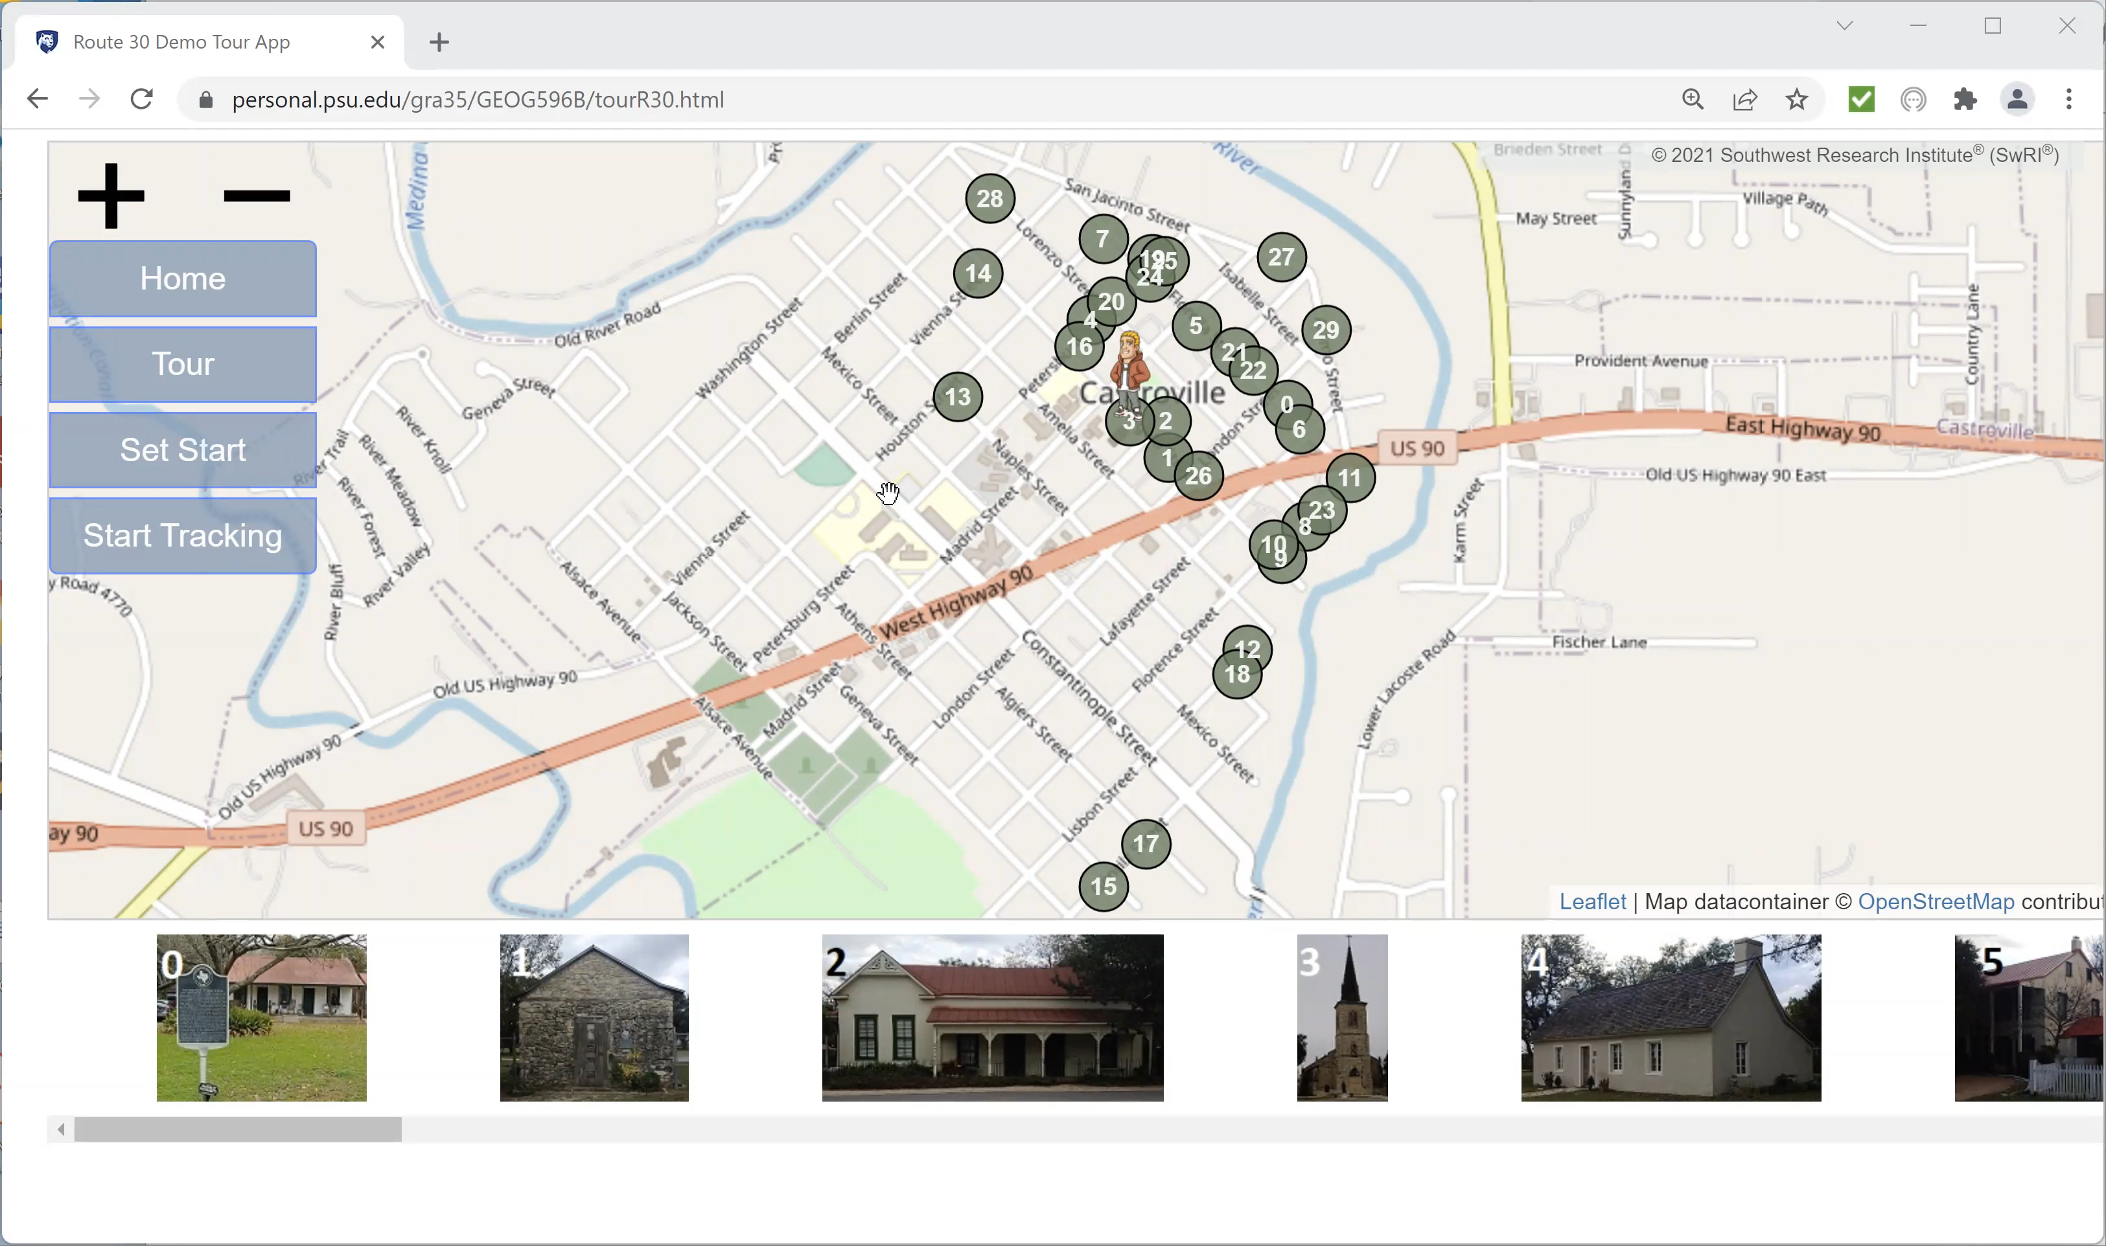
Demo Web App
Implementation
Web app URL: https://personal.psu.edu/gra35/GEOG596B/tourR30.html

Slide 35
Background
Routing Library Design
Web App Implementation
How You can use the Library
Benefits to using the Library

Slide 36
Distribution
Using the Library
GitHub Public Repository
Demo Web App
Public repository on GitHub
Available under an MIT-Type license
Free for commercial and non-commercial uses
Route30 Library

Slide 37
Data Files – Points of Interest
Using the Library
POIs
Historical properties from the Castroville Tour Guide (CACC, 2017) as well as finding them on my own
POIs file
Street Network from Harvard Dataverse (Boeing, 2017)
Nodes file
Edges file
Required Fields

Slide 38
Data Files – Points of Interest
Using the Library
Filter Criteria
POIs
Historical properties from the Castroville Tour Guide (CACC, 2017) as well as finding them on my own
POIs file
Street Network from Harvard Dataverse (Boeing, 2017)
Nodes file
Edges file

Slide 39
Data Files – Points of Interest
Using the Library
GeoJSON Points of Interest Feature Collection
{
“type”: “FeatureCollection”,
“features”: [
{
“type”: “Feature”,
“id”: “0”,
“properties”: {
“name”: “Henri Castro Homestead”,
“priority”: 1,
“popup”: “Henri Castro Homestead - 1845”,
“criteria”: [“house”, “1800s”],
“Year”: 1845,
“Address”: “1109 Fiorella Street”
},
“geometry”: {
“type”: “Point”,
“coordinates”: [-98.882, 29.351]
}
},
{
…. Additional features follow the same format as above….
}
]
}
Historical properties from the Castroville Tour Guide (CACC, 2017) as well as finding them on my own
POIs file
Street Network from Harvard Dataverse (Boeing, 2017)
Nodes file
Edges file
One POI

Slide 40
Data Files – Points of Interest
Using the Library
POI File Displayed in GitHub
Historical properties from the Castroville Tour Guide (CACC, 2017) as well as finding them on my own
POIs file
Street Network from Harvard Dataverse (Boeing, 2017)
Nodes file
Edges file

Slide 41
Data Files – Street Network
Using the Library
Edges
Historical properties from the Castroville Tour Guide (CACC, 2017) as well as finding them on my own
POIs file
Street Network from Harvard Dataverse (Boeing, 2017)
Nodes file
Edges file
Nodes

Slide 42
Data Files – Street Network
Using the Library
Edges
Historical properties from the Castroville Tour Guide (CACC, 2017) as well as finding them on my own
POIs file
Street Network from Harvard Dataverse (Boeing, 2017)
Nodes file
Edges file
Correspond
Nodes

Slide 43
Data Files – Street Network
Using the Library
Filter Criteria
Edges
Historical properties from the Castroville Tour Guide (CACC, 2017) as well as finding them on my own
POIs file
Street Network from Harvard Dataverse (Boeing, 2017)
Nodes file
Edges file
Nodes

Slide 44
Invoking the Library
Using the Library
Web App
Four Steps:
Web app commands library to initialize
Library initializes
Web app commands library to generate route
Library responds with best solution found
1
3
4
Route30 Library
2
Files

Slide 45
Step 1: Command: Initialize Library
Using the Library
Web App
“R30LoadData(POI, Nodes, Edges)”
Calls
1
3
4
Route30 Library
First
Entry Point
Route30 Library
2
Files

Slide 46
Step 2: Response: Library Initializes
Using the Library
Web App
“R30LoadData(POI, Nodes, Edges)” executes
Library imports components
Library loads data files
1
3
4
Route30 Library
Route30 Library
2
Files
Components

Slide 47
Step 2: Response: Library Initializes
Using the Library
Web App
“R30LoadData(POI, Nodes, Edges)” executes
Library imports components
Library loads data files
1
3
4
Route30 Library
Data Files
2
Files

Slide 48
Step 3: Command: Generate Route
Using the Library
Web App
Web App
“R30Generate(routeParameter)”
Calls
1
1
3
3
4
4
Route30 Library
Route30 Library
Second
Entry Point
Route30 Library
2
2
Data Files
Files

Slide 49
Step 3: Command: Generate Route
Using the Library
Web App
“R30Generate(routeParameter)”
Calls
1
3
4
Parameter Passed to Routing Library
var routeParameter = {
maxDistance: 3.5,
userStart: [-98.87934, 29.35596],
poiFilter: [["house", "church", "commercial"],
["1800s", "1900s"]],
edgeFilter: [["acc_yes", "acc_no"]],
algorithm: [5.0, 0.9, 200, 500, 150]
}
Route30 Library
2
Files
Configuration parameters from tuning

Slide 50
Step 4: Response: Library Generates Best Solution
Using the Library
Web App
Generated Route in GeoJSON Format:
1
3
4
1. Distance in kilometers
Route30 Library
2. Sequential list of POIs
2
Files
3. Paths Between POIs

Slide 51
Background
Routing Library Design
Web App Implementation
How You can use the Library
Benefits to using the Library

Slide 52
OpenRouteService Comparison
Benefits
Compare unconstrained solutions
5.7 km
5.3 km
The route should only cross at this one location to the east.
Not here.
OpenRouteService (The Heidelberg Institute for Geoinformation Technology, 2022)
Route30

Slide 53
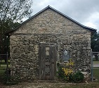
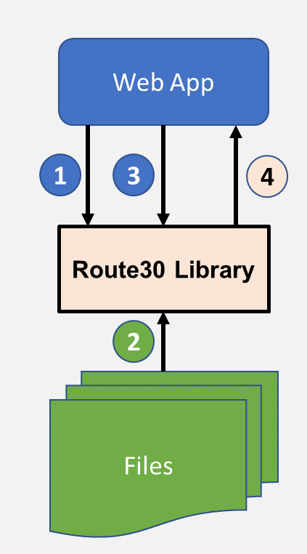
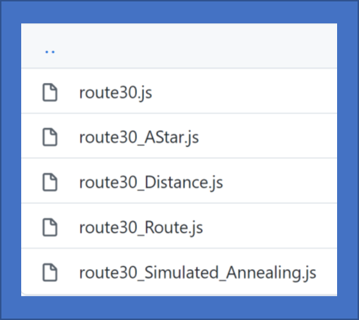
Benefits to Using Library
Benefits
Direct control over inputs
Minimal data input
Library uses plug-ins
Library is free and easy to use
Can tune the algorithm
Library is expandable
First Stone St. Louis Church - 1849

Slide 54

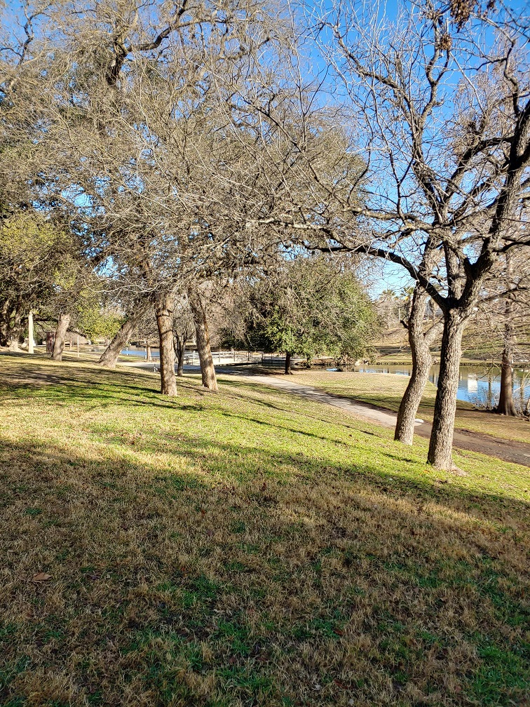
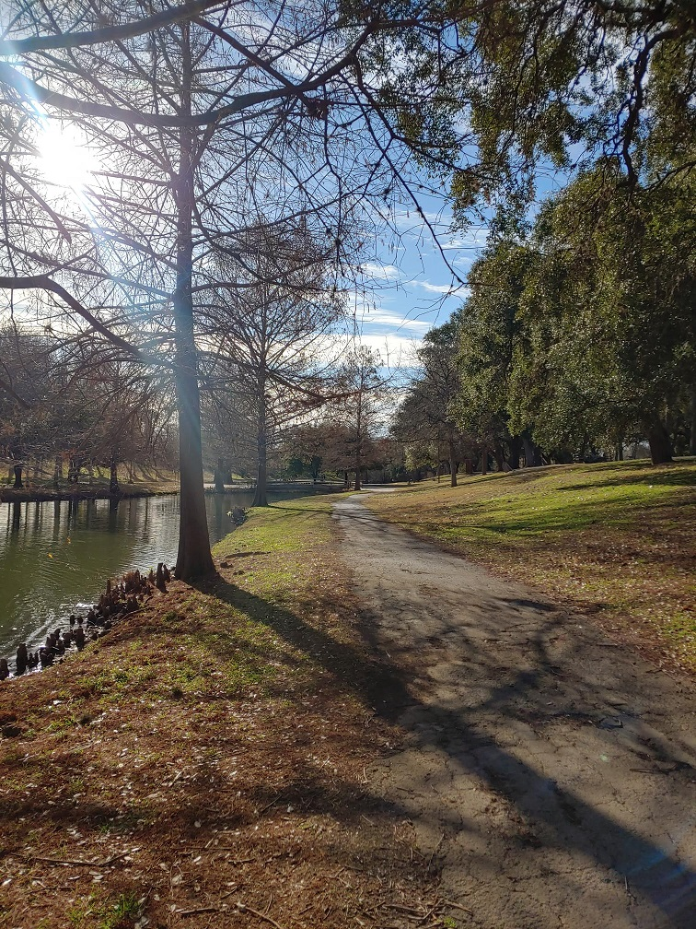
Future Uses
Benefits
Warehouse
Public works department
Natural area where no street network exists
Museum or warehouse routing
Small business delivery operations
Experimental platform for testing new algorithms
Natural Areas with Trails

Slide 55
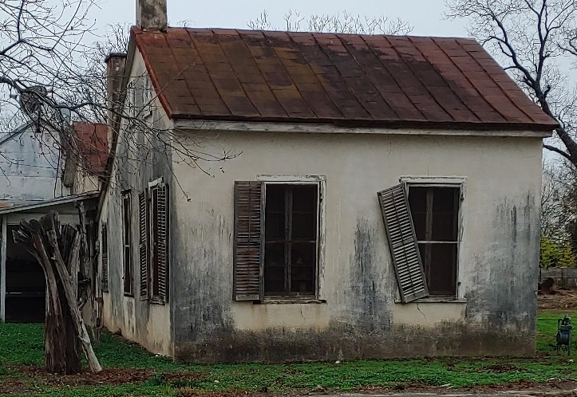
Summary
1. FOSS client-side routing library
Routing component
Distance matrix component
2. Demo web app
Demonstrates routing library
Displays filtered and constrained routes
3. How you can use the library
Deployed on GitHub
Uses standard data format
Called from your web app
4. Benefits
Greater control over inputs
Affordable/Easy to implement
Historical Significance Unknown

Slide 56
Acknowledgements
The author expresses his gratitude to Dr. Jan Oliver Wallgrün, Penn State University, for his support in the development of Route30.
Also, special thanks to:
Ms. Adrienne Goldsberry, Penn State
Ms. Lora Robbins, Development Services Superintendent, City of Hondo, Texas
Hans Meat Market - 1910

Slide 57
Questions?
GitHub Repository: https://github.com/savage507051/Route30
Web app URL: https://personal.psu.edu/gra35/GEOG596B/tourR30.html
Landmark Inn - 1849

Slide 58
References
Boeing, G. (2017). U.S. Street Network Shapefiles, Node/Edge Lists, and GraphML Files. https://doi.org/10.7910/DVN/CUWWYJ, Harvard Dataverse, V2.
Castroville Area Chamber of Commerce (CACC). (2017). Wilkomme…Your guide to Castroville. Accessed September 16, 2021, from Link.
Curry, C. (2020). Factorial (n!) algorithm complexity & traveling salesman problem – Data structures and algorithms. Accessed August 23, 2021, from Link.
The Heidelberg Institute for Geoinformation Technology. (2022). OpenRouteService. Accessed January 24, 2022, from Link.
Jacobson, L. (2013). Simulated annealing for beginners. Accessed August 24, 2021, from Link.
Lester, P. (2005). A* pathfinding for beginners. Accessed September 4, 2021, from Link.
Lojkine, O. (2018). Salesman. Accessed August 24, 2021, from Link.
Press, W. H., Teukolsky, S.A, Vetterling, W.T., & Flannery, B.P. (1992). Numerical recipes in C (2nd ed.). Cambridge, UK: Cambridge University Press.
Roy, B. (2019). A-Star (A*) search algorithm. Accessed September 4, 2021, from Link.
Schneider, T. (2014). The traveling salesman with simulated annealing, R, and Shiny. Accessed August 24, 2021, from Link.
Swift, N. (2017). Easy A* (star) pathfinding. Accessed September 4, 2021, from Link.
Walker, J. (2018). Simulated annealing – The travelling salesman problem. Accessed August 24, 2021, from Link.

